Slide 1

Creating a Better Digital Logic Simulation for Teachers and Students
- Interactive Logic -
A Python App for Designing Circuits
Created by:
Flanders Lorton

Slide 2

Rationale
When learning the basics of electrical engineering, it can often be difficult to format information in a way that is easy to teach and learn.
From taking electrical engineering courses at LMU, there were a number of things I found frustrating with the digital logic software we used as a class.
Knowing that other students were frustrated by these same shortcomings, I decided to rebuild the basic functionality of this software from scratch, with simple intuitive design as the primary goal.

Slide 3
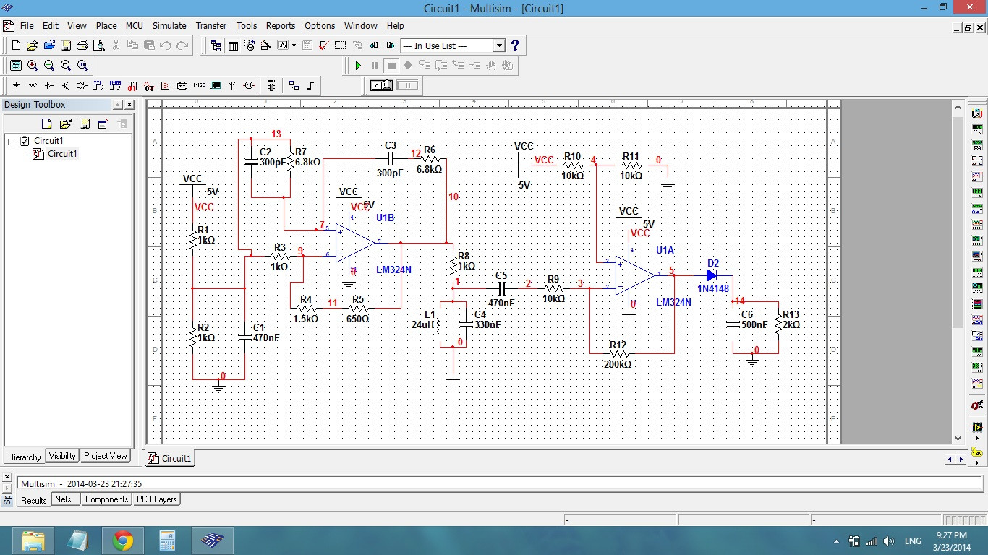

Slide 4
Intention
My project is to create a standalone desktop application that combines:
Intuitive design
Straightforward interactions
A suite of basic features and functionality for teachers and students to visualize digital logic circuits effectively.

Slide 5
Current Features
Standalone application built in Python 2.7 using the PyGame graphics library.
Digital logic simulation from the seven basic gates
Interactive input components (switches)
Clocks
Simple output lights
Truth table generation
Timing diagram generation.
Save / Load circuits

Slide 6
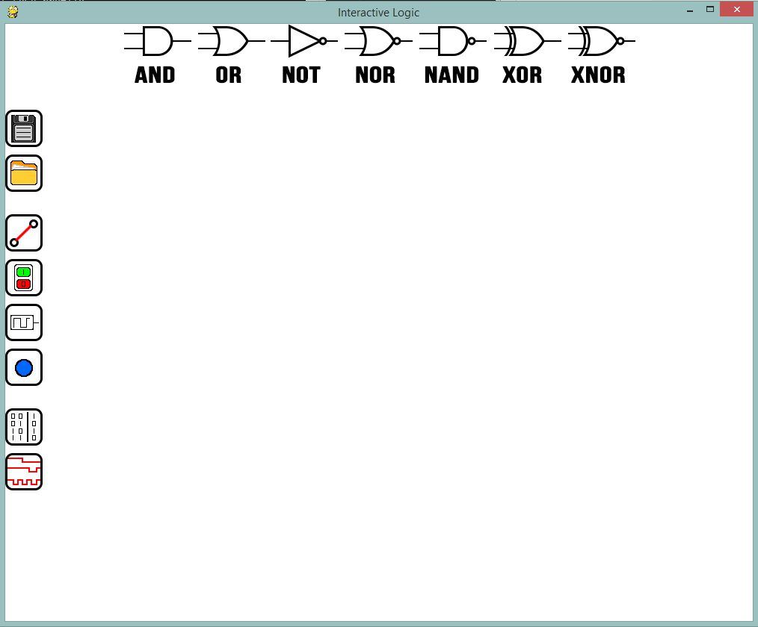

Slide 7
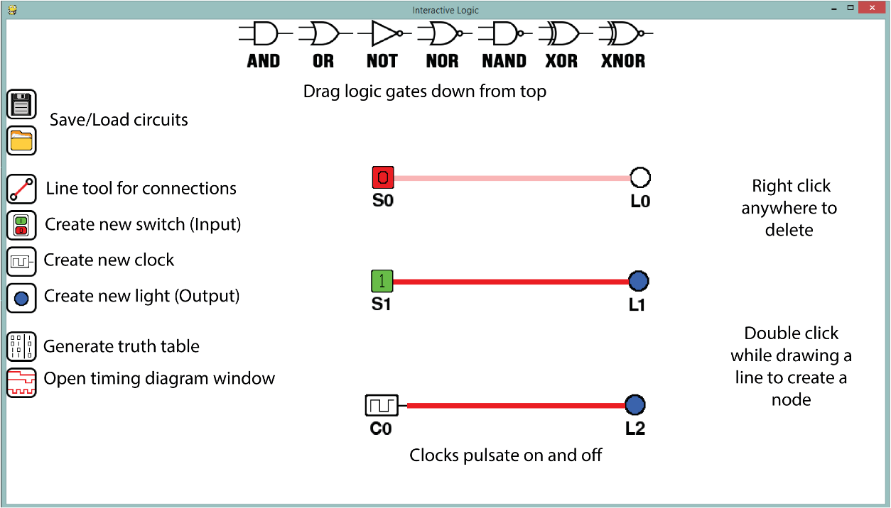

Slide 8
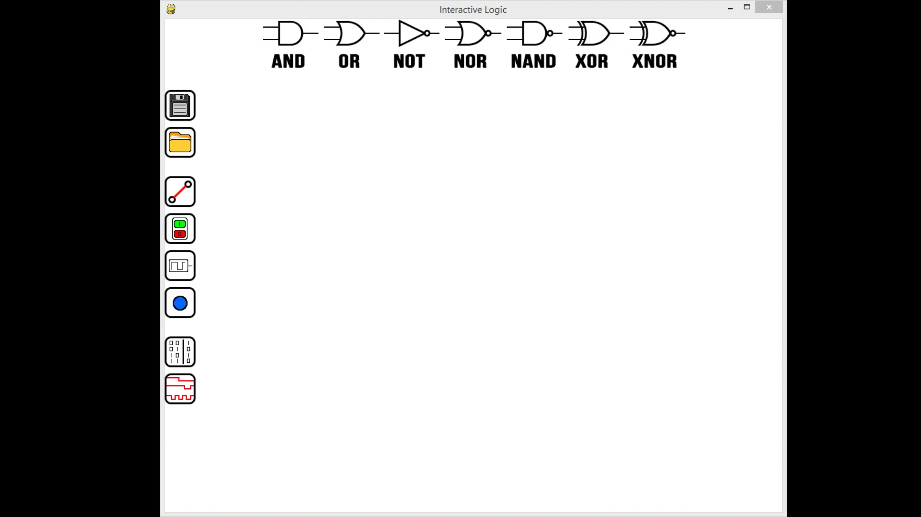
https://www.youtube.com/watch?v=14w294m3e5E

Slide 9
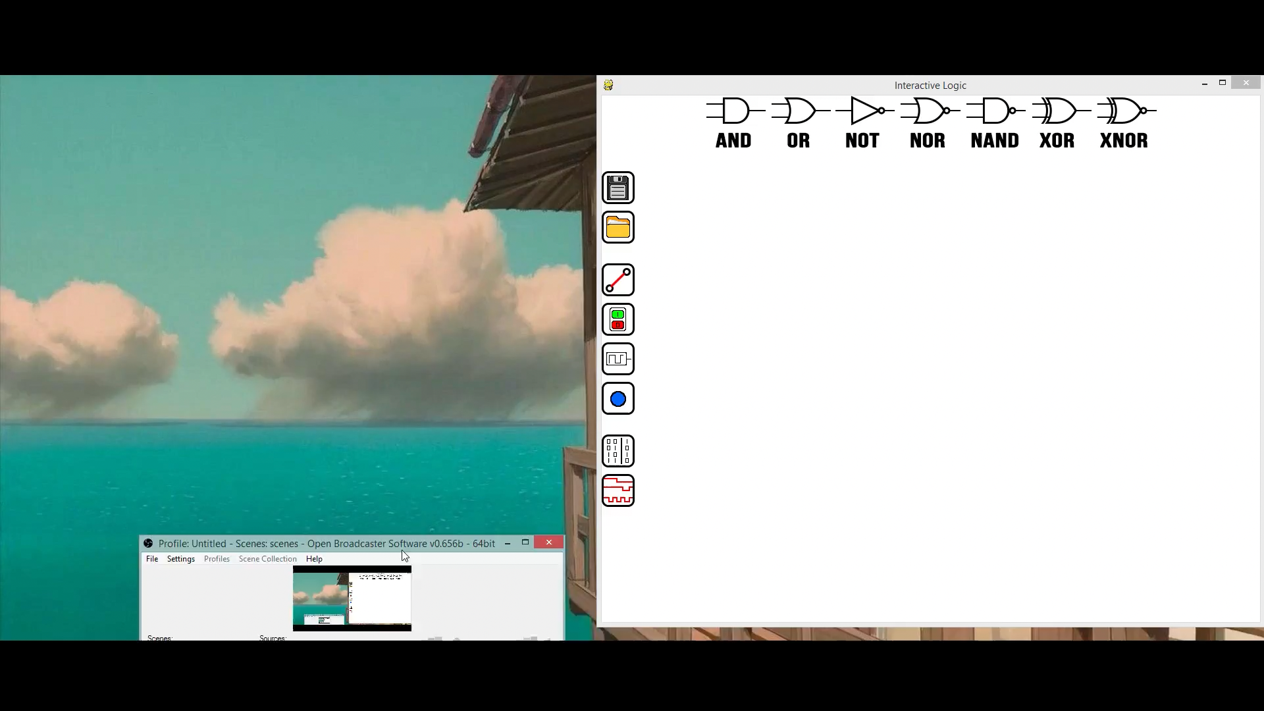
https://www.youtube.com/watch?v=-fWIXk9YBr8

Slide 10
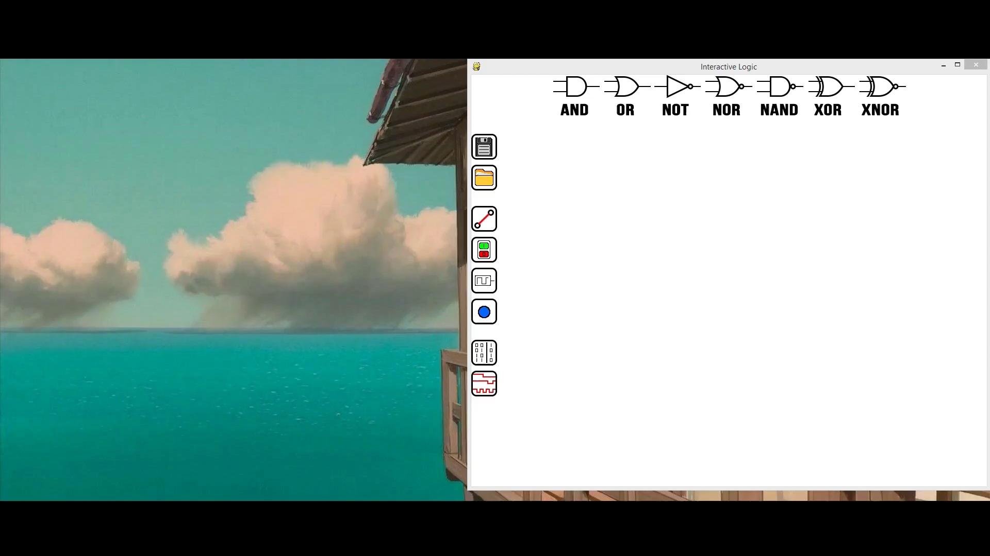
https://www.youtube.com/watch?v=VrhRNDn9eFg

Slide 11
What’s Missing?
MSI (Medium Scale Integration)
Image Exporting (Built In Screenshots)
Multi-Object Dragging
Comprehensive Component Library
Full Distributions/ System Builds

Slide 12
Applications
In the program's current state it is better suited to teaching/learning about individual components as opposed to entire circuits.
Adding functionality to save and import components as usable “black boxes” would allow Interactive Logic to be used as a comprehensive circuit simulation software for introductory EE classes

Slide 13
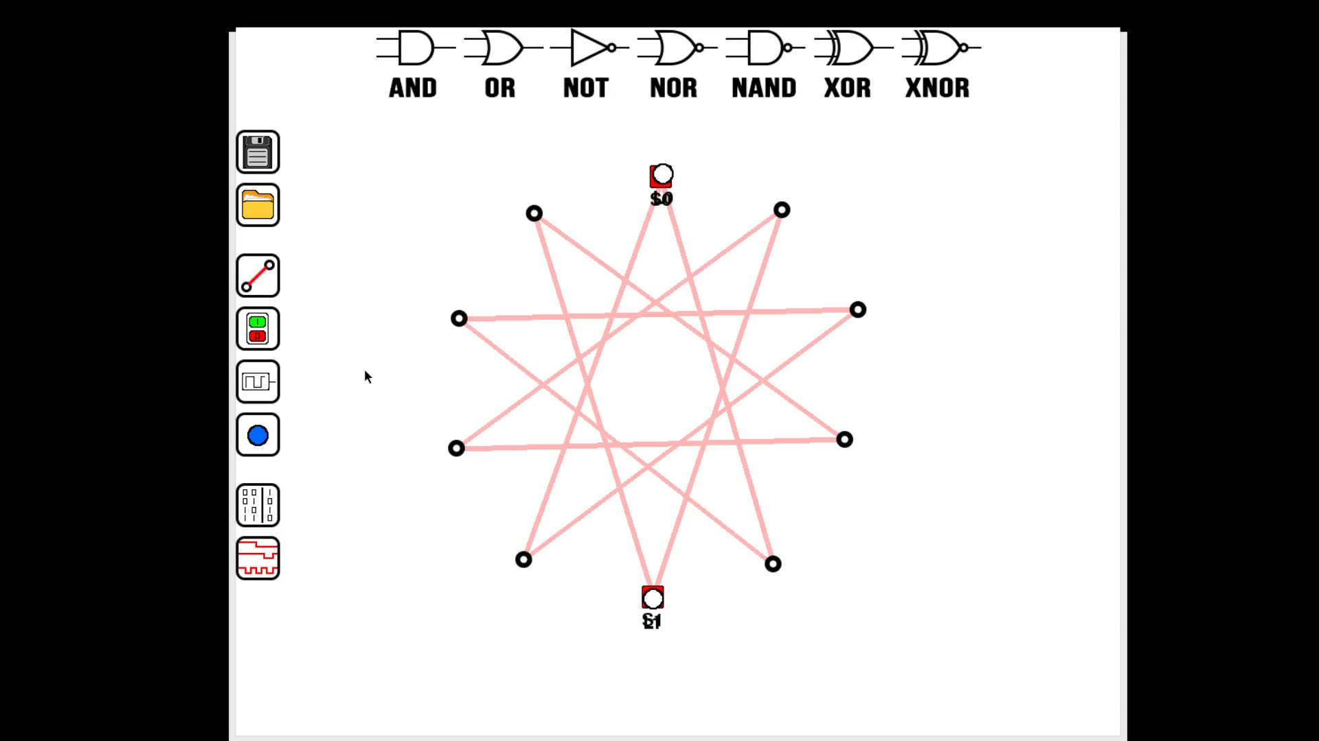
https://www.youtube.com/watch?v=Wl9su6qirPo

Slide 14
Questions?

Slide 15
